Slide 1
ICT-LEARNFACTORY
Multi-User-Applikationen
objektorientiert realisieren
Softwarearchitektur
08/16/26
Notes:
[Sources]
- Redesign follows the supplied ICT-LearnFactory Brand Guide (Aptos typography; Charcoal Flux #272726, Hyper Teal #45D9C7, Lumen Zest #D9EB12, Abyss Teal #29948C; geometric brand-mark pattern language).
- Slide content is preserved from the uploaded source presentation 02_Softwarearchitektur.odp.
[/Sources]

Slide 2
Handlungsnotwendige Kenntnisse
2.2 Kennt wichtige Architekturvarianten und -konzepte (Client/Server, Multi-Tier, Middleware, Framework, Klassenbibliothek).
ICT-LEARNFACTORY
Softwarearchitektur
Notes:
[Sources]
- Redesign follows the supplied ICT-LearnFactory Brand Guide (Aptos typography; Charcoal Flux #272726, Hyper Teal #45D9C7, Lumen Zest #D9EB12, Abyss Teal #29948C; geometric brand-mark pattern language).
- Slide content is preserved from the uploaded source presentation 02_Softwarearchitektur.odp.
[/Sources]

Slide 3
Ziele
Du weisst, was man unter Softwarearchitektur versteht.
Du kennst wichtige Architekturvarianten und –patterns.
Du kennst die Vor- und Nachteile von verschiedenen Architekturen.
Du weisst, worauf du beim Entwurf der Softwarearchitektur bei Multiuser-Applikationen achten musst.
ICT-LEARNFACTORY
Softwarearchitektur
Notes:
[Sources]
- Redesign follows the supplied ICT-LearnFactory Brand Guide (Aptos typography; Charcoal Flux #272726, Hyper Teal #45D9C7, Lumen Zest #D9EB12, Abyss Teal #29948C; geometric brand-mark pattern language).
- Slide content is preserved from the uploaded source presentation 02_Softwarearchitektur.odp.
[/Sources]

Slide 4
Softwarearchitektur
Was ist das?
Die Aufteilung von Zuständigkeiten von Software in verschiedene
Komponenten
Module
Schichten
Exakt definierte Schnittstellen, z.B.
APIs als Schnittstelle zum Server
Sprachen (z.B. SQL als Schnittstelle zur Datenbank)
ICT-LEARNFACTORY
Softwarearchitektur
Notes:
[Sources]
- Redesign follows the supplied ICT-LearnFactory Brand Guide (Aptos typography; Charcoal Flux #272726, Hyper Teal #45D9C7, Lumen Zest #D9EB12, Abyss Teal #29948C; geometric brand-mark pattern language).
- Slide content is preserved from the uploaded source presentation 02_Softwarearchitektur.odp.
[/Sources]

Slide 5
Architekturbegriffe
Modul
Definiert eine funktionale Einheit, z.B.
Userverwaltung
Zeiterfassung
Notifikationen
ICT-LEARNFACTORY
Softwarearchitektur
Notes:
[Sources]
- Redesign follows the supplied ICT-LearnFactory Brand Guide (Aptos typography; Charcoal Flux #272726, Hyper Teal #45D9C7, Lumen Zest #D9EB12, Abyss Teal #29948C; geometric brand-mark pattern language).
- Slide content is preserved from the uploaded source presentation 02_Softwarearchitektur.odp.
[/Sources]

Slide 6
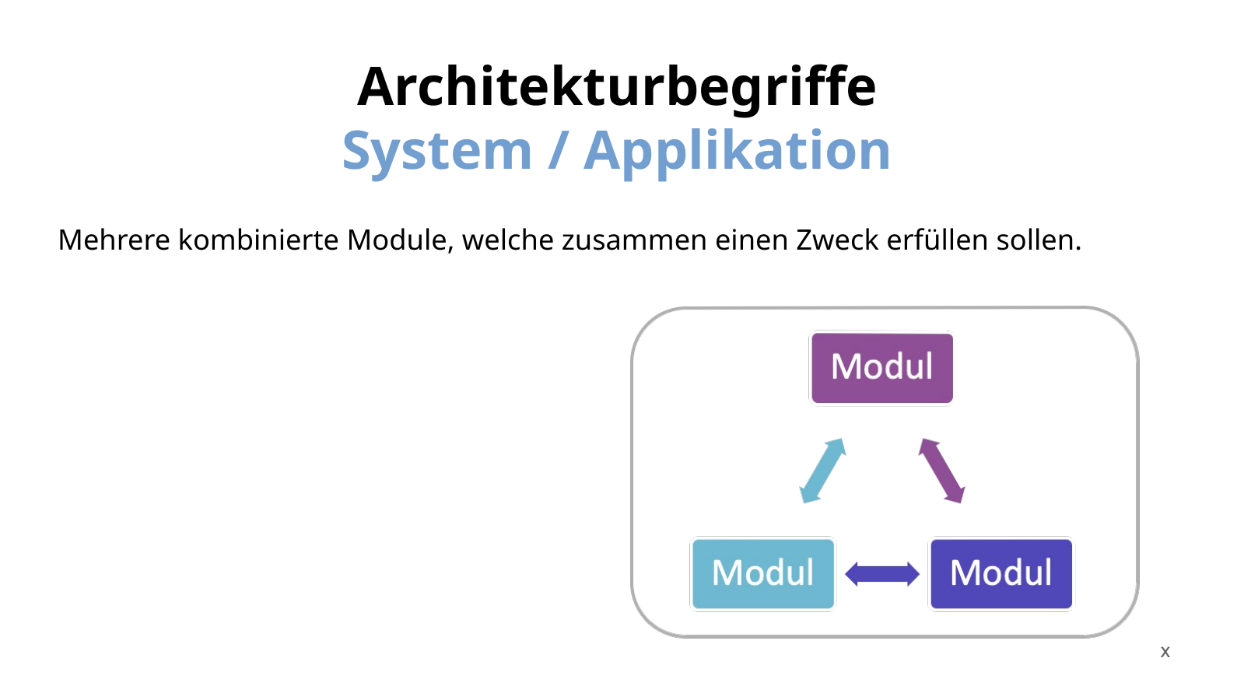
Architekturbegriffe
System / Applikation
Mehrere kombinierte Module, welche zusammen einen Zweck erfüllen sollen.
ICT-LEARNFACTORY
Softwarearchitektur
Notes:
[Sources]
- Redesign follows the supplied ICT-LearnFactory Brand Guide (Aptos typography; Charcoal Flux #272726, Hyper Teal #45D9C7, Lumen Zest #D9EB12, Abyss Teal #29948C; geometric brand-mark pattern language).
- Slide content is preserved from the uploaded source presentation 02_Softwarearchitektur.odp.
[/Sources]

Slide 7
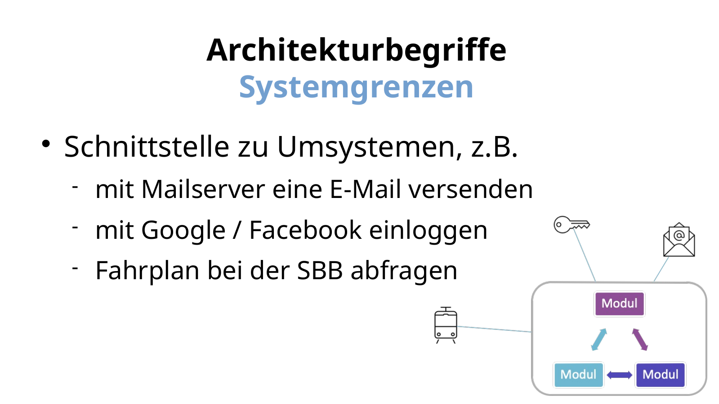
Architekturbegriffe
Systemgrenzen
Schnittstelle zu Umsystemen, z.B.
mit Mailserver eine E-Mail versenden
mit Google / Facebook einloggen
Fahrplan bei der SBB abfragen
ICT-LEARNFACTORY
Softwarearchitektur
Notes:
[Sources]
- Redesign follows the supplied ICT-LearnFactory Brand Guide (Aptos typography; Charcoal Flux #272726, Hyper Teal #45D9C7, Lumen Zest #D9EB12, Abyss Teal #29948C; geometric brand-mark pattern language).
- Slide content is preserved from the uploaded source presentation 02_Softwarearchitektur.odp.
[/Sources]

Slide 8
Architekturbegriffe
Schichten
Physikalische Schichten
Logische Schichten
ICT-LEARNFACTORY
Softwarearchitektur
Notes:
[Sources]
- Redesign follows the supplied ICT-LearnFactory Brand Guide (Aptos typography; Charcoal Flux #272726, Hyper Teal #45D9C7, Lumen Zest #D9EB12, Abyss Teal #29948C; geometric brand-mark pattern language).
- Slide content is preserved from the uploaded source presentation 02_Softwarearchitektur.odp.
[/Sources]

Slide 9
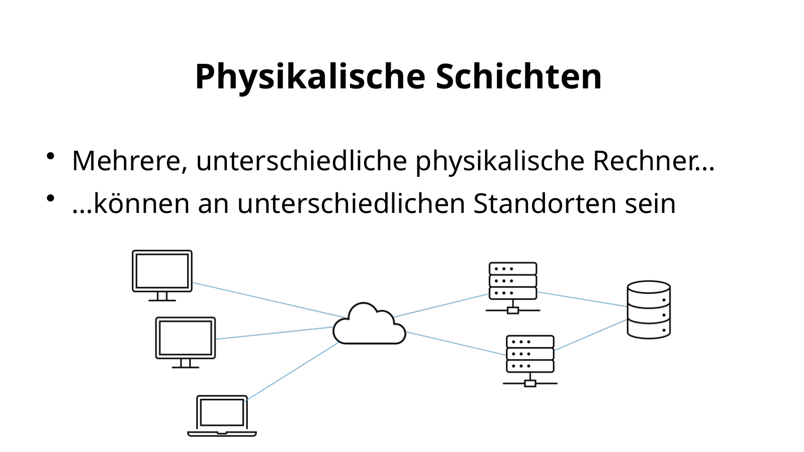
Physikalische Schichten
Mehrere, unterschiedliche physikalische Rechner…
…können an unterschiedlichen Standorten sein
ICT-LEARNFACTORY
Softwarearchitektur
Notes:
[Sources]
- Redesign follows the supplied ICT-LearnFactory Brand Guide (Aptos typography; Charcoal Flux #272726, Hyper Teal #45D9C7, Lumen Zest #D9EB12, Abyss Teal #29948C; geometric brand-mark pattern language).
- Slide content is preserved from the uploaded source presentation 02_Softwarearchitektur.odp.
[/Sources]

Slide 10
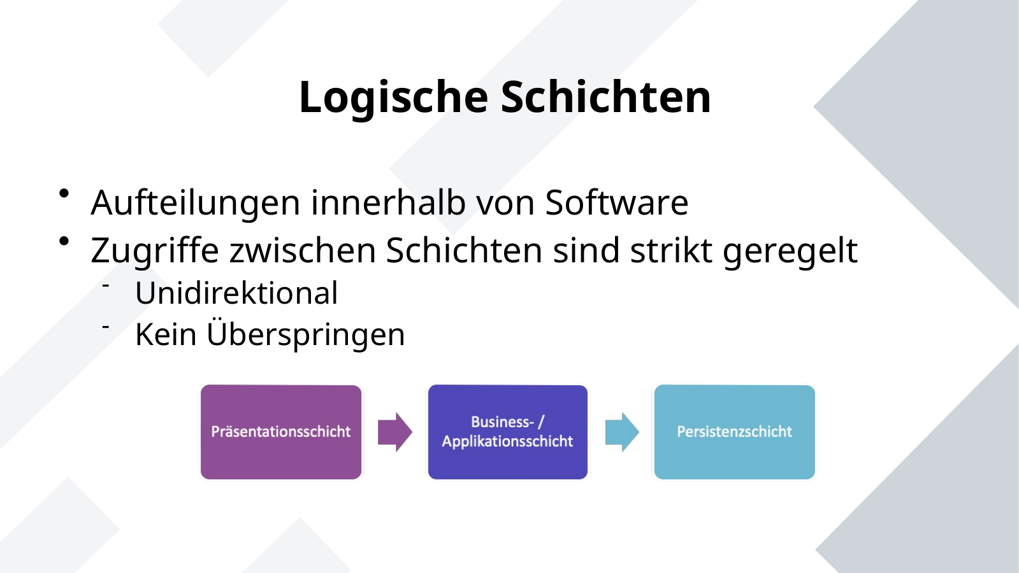
Logische Schichten
Aufteilungen innerhalb von Software
Zugriffe zwischen Schichten sind strikt geregelt
Unidirektional
Kein Überspringen
ICT-LEARNFACTORY
Softwarearchitektur
Notes:
[Sources]
- Redesign follows the supplied ICT-LearnFactory Brand Guide (Aptos typography; Charcoal Flux #272726, Hyper Teal #45D9C7, Lumen Zest #D9EB12, Abyss Teal #29948C; geometric brand-mark pattern language).
- Slide content is preserved from the uploaded source presentation 02_Softwarearchitektur.odp.
[/Sources]

Slide 11
Softwarearchitektur
Wozu?
Vorteile
Überschaubarkeit
Wiederverwendbarkeit
Skalierbarkeit
Wartbarkeit
Parallelisierbare Entwicklung
Nachteile
Höhere Komplexität
Performance
ICT-LEARNFACTORY
Softwarearchitektur
Notes:
[Sources]
- Redesign follows the supplied ICT-LearnFactory Brand Guide (Aptos typography; Charcoal Flux #272726, Hyper Teal #45D9C7, Lumen Zest #D9EB12, Abyss Teal #29948C; geometric brand-mark pattern language).
- Slide content is preserved from the uploaded source presentation 02_Softwarearchitektur.odp.
[/Sources]

Slide 12
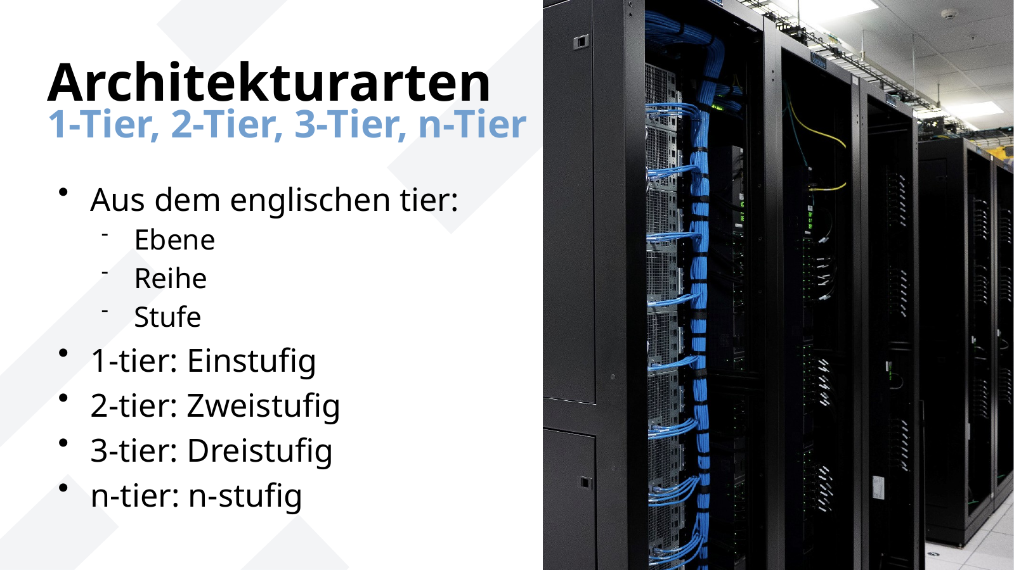
Architekturarten
1-Tier, 2-Tier, 3-Tier, n-Tier
Aus dem englischen tier:
Ebene
Reihe
Stufe
1-tier: Einstufig
2-tier: Zweistufig
3-tier: Dreistufig
n-tier: n-stufig
ICT-LEARNFACTORY
Softwarearchitektur
Notes:
[Sources]
- Redesign follows the supplied ICT-LearnFactory Brand Guide (Aptos typography; Charcoal Flux #272726, Hyper Teal #45D9C7, Lumen Zest #D9EB12, Abyss Teal #29948C; geometric brand-mark pattern language).
- Slide content is preserved from the uploaded source presentation 02_Softwarearchitektur.odp.
[/Sources]

Slide 13
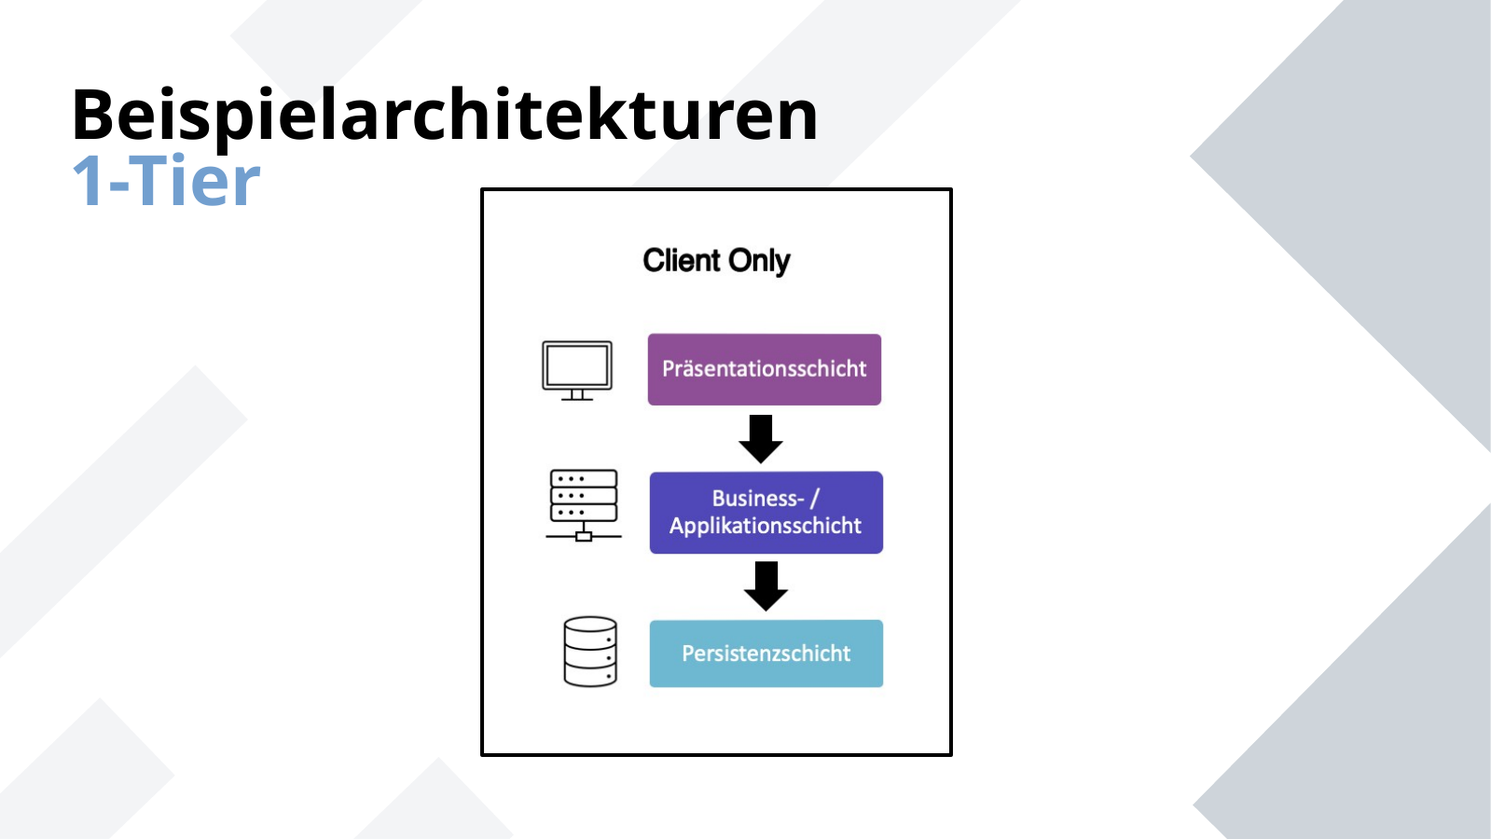
Beispielarchitekturen
1-Tier
ICT-LEARNFACTORY
Softwarearchitektur
Notes:
[Sources]
- Redesign follows the supplied ICT-LearnFactory Brand Guide (Aptos typography; Charcoal Flux #272726, Hyper Teal #45D9C7, Lumen Zest #D9EB12, Abyss Teal #29948C; geometric brand-mark pattern language).
- Slide content is preserved from the uploaded source presentation 02_Softwarearchitektur.odp.
[/Sources]

Slide 14
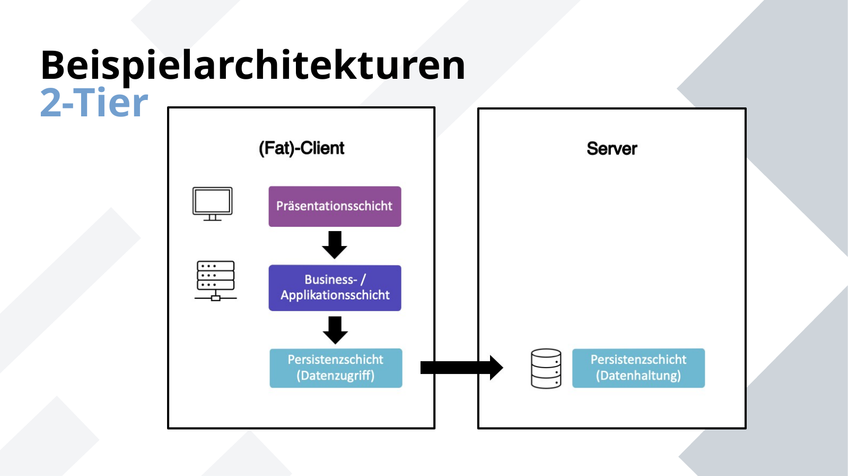
Beispielarchitekturen
2-Tier
ICT-LEARNFACTORY
Softwarearchitektur
Notes:
[Sources]
- Redesign follows the supplied ICT-LearnFactory Brand Guide (Aptos typography; Charcoal Flux #272726, Hyper Teal #45D9C7, Lumen Zest #D9EB12, Abyss Teal #29948C; geometric brand-mark pattern language).
- Slide content is preserved from the uploaded source presentation 02_Softwarearchitektur.odp.
[/Sources]

Slide 15
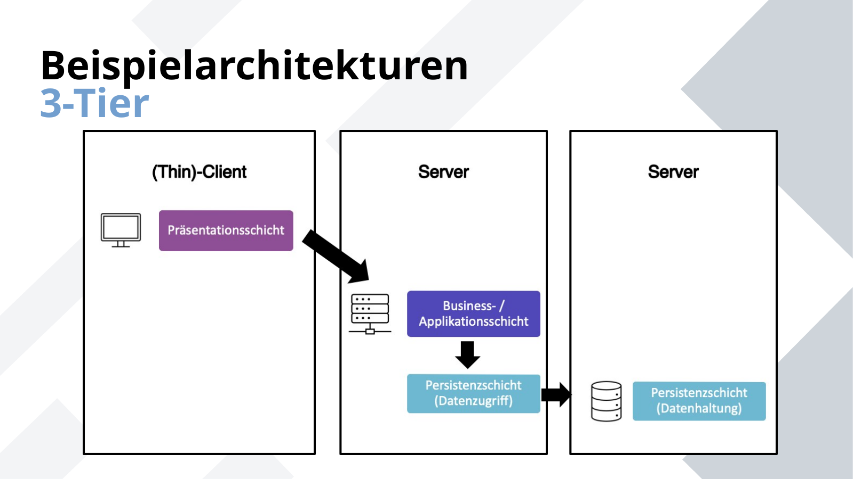
Beispielarchitekturen
3-Tier
ICT-LEARNFACTORY
Softwarearchitektur
Notes:
[Sources]
- Redesign follows the supplied ICT-LearnFactory Brand Guide (Aptos typography; Charcoal Flux #272726, Hyper Teal #45D9C7, Lumen Zest #D9EB12, Abyss Teal #29948C; geometric brand-mark pattern language).
- Slide content is preserved from the uploaded source presentation 02_Softwarearchitektur.odp.
[/Sources]

Slide 16
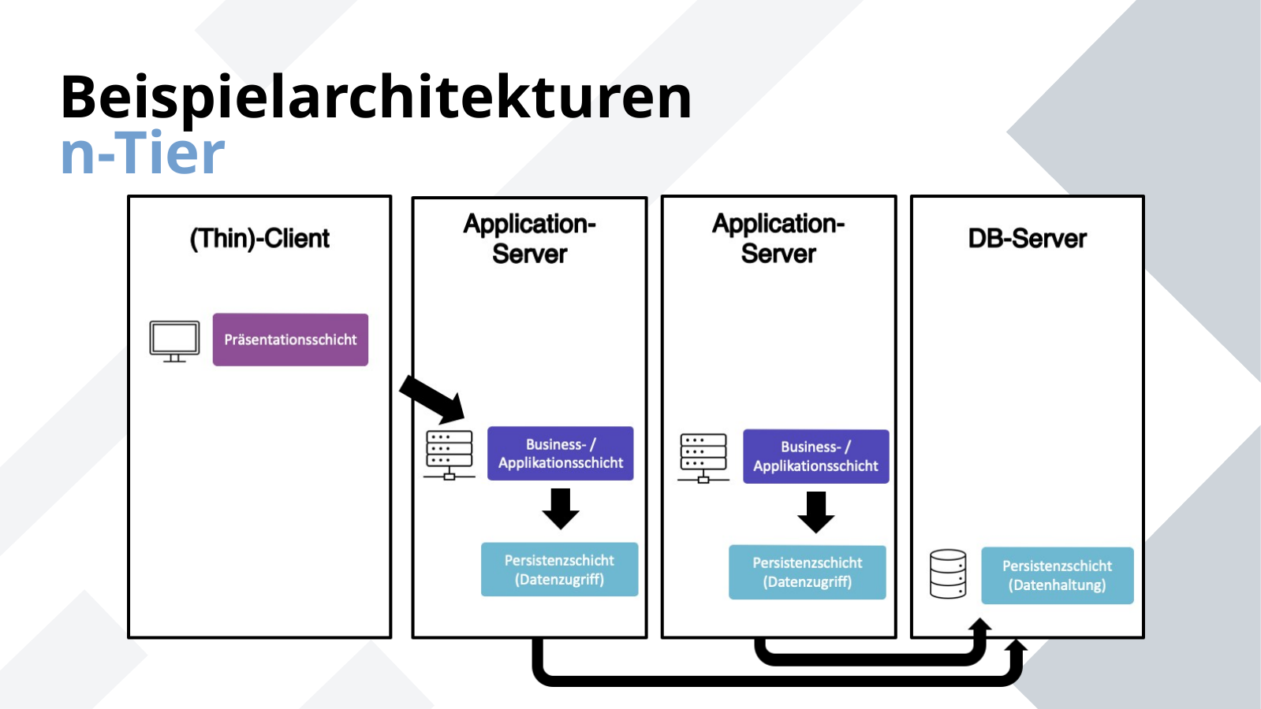
Beispielarchitekturen
n-Tier
ICT-LEARNFACTORY
Softwarearchitektur
Notes:
[Sources]
- Redesign follows the supplied ICT-LearnFactory Brand Guide (Aptos typography; Charcoal Flux #272726, Hyper Teal #45D9C7, Lumen Zest #D9EB12, Abyss Teal #29948C; geometric brand-mark pattern language).
- Slide content is preserved from the uploaded source presentation 02_Softwarearchitektur.odp.
[/Sources]

Slide 17
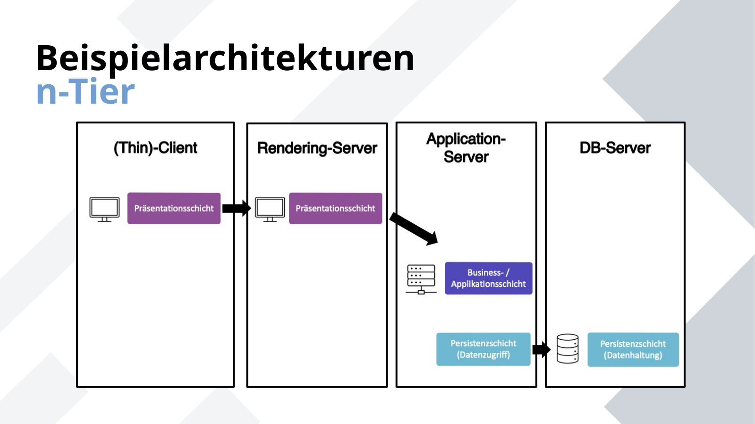
Beispielarchitekturen
n-Tier
ICT-LEARNFACTORY
Softwarearchitektur
Notes:
[Sources]
- Redesign follows the supplied ICT-LearnFactory Brand Guide (Aptos typography; Charcoal Flux #272726, Hyper Teal #45D9C7, Lumen Zest #D9EB12, Abyss Teal #29948C; geometric brand-mark pattern language).
- Slide content is preserved from the uploaded source presentation 02_Softwarearchitektur.odp.
[/Sources]

Slide 18
Beispielarchitekturen
n-Tier
Beliebig viele weitere Schichten möglich
Caching
Messaging-Layers
Security
ICT-LEARNFACTORY
Softwarearchitektur
Notes:
[Sources]
- Redesign follows the supplied ICT-LearnFactory Brand Guide (Aptos typography; Charcoal Flux #272726, Hyper Teal #45D9C7, Lumen Zest #D9EB12, Abyss Teal #29948C; geometric brand-mark pattern language).
- Slide content is preserved from the uploaded source presentation 02_Softwarearchitektur.odp.
[/Sources]

Slide 19
Fragen?
ICT-LEARNFACTORY
Softwarearchitektur
Notes:
[Sources]
- Redesign follows the supplied ICT-LearnFactory Brand Guide (Aptos typography; Charcoal Flux #272726, Hyper Teal #45D9C7, Lumen Zest #D9EB12, Abyss Teal #29948C; geometric brand-mark pattern language).
- Slide content is preserved from the uploaded source presentation 02_Softwarearchitektur.odp.
[/Sources]

